Slide 1

RPG Unit Testing Made Easy in VS Code
Sanjula Ganepola
Software Developer – IBM i App Dev & AI Toolchain
Sanjula.Ganepola@ibm.com
2025 July

Slide 2
Agenda
Why Build Tooling for Unit Testing?
Basics of RPGUnit
IBM i Testing Extension Demo
How to write tests and generate test stubs?
How to run tests with code coverage?
IBM i Testing CLI Demo
How to run tests outside VS Code?
How to run tests in a CI/CD pipeline?
Code Coverage

Slide 3
Why Build Tooling for Unit Testing?

Slide 4










What is missing in the VS Code stack?
Other
watsonx Code Assistant for i
Vendor Extensions
AI Tooling
Code for IBM i
IBM i Languages
Db2 for IBM i
IBM i Renderer
CL
Source Orbit
IBM i Project Explorer
Code Coverage
RPGLE
IBM i Debug
Language Extensions
Other Tooling

Slide 5
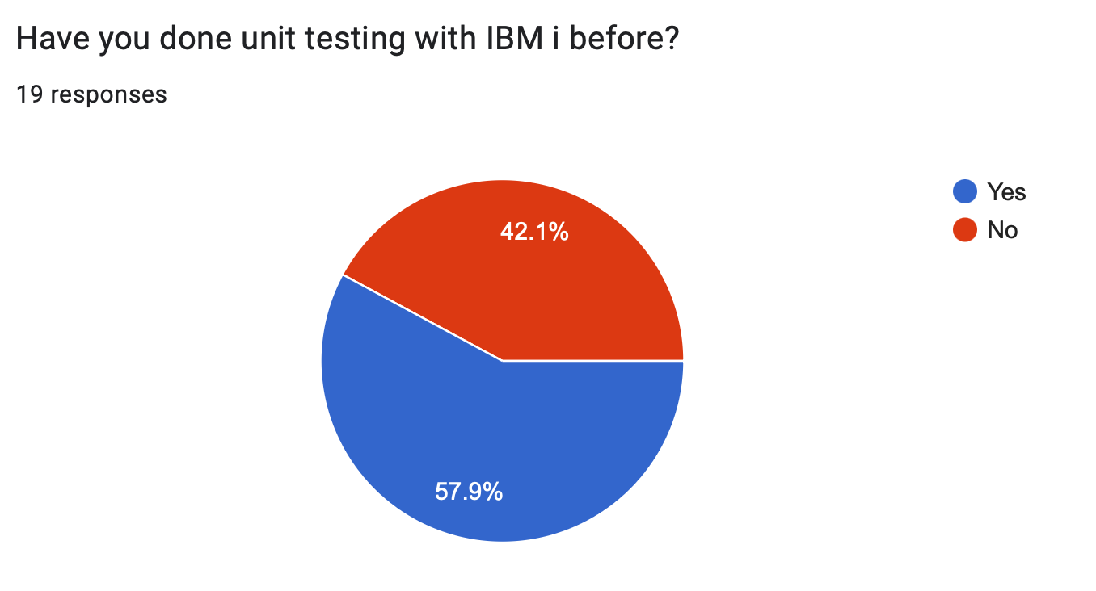
We did a survey…

Slide 6
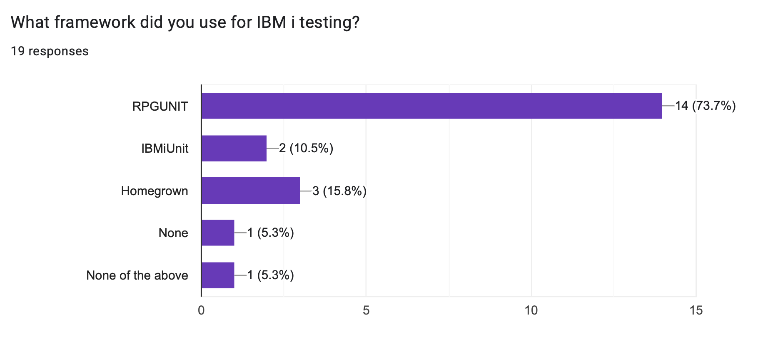
We did a survey…

Slide 7
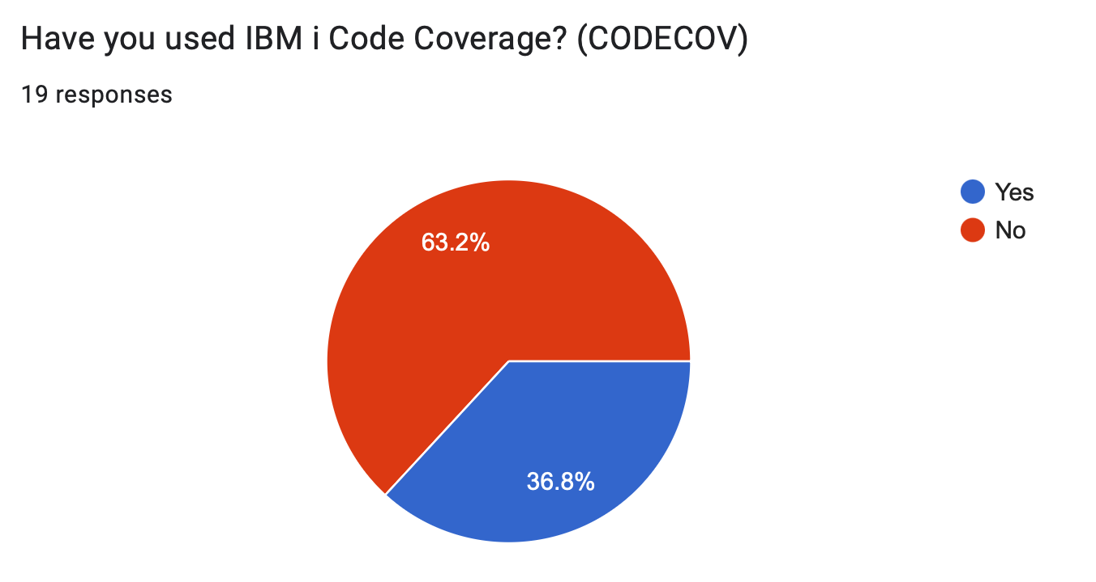
We did a survey…

Slide 8
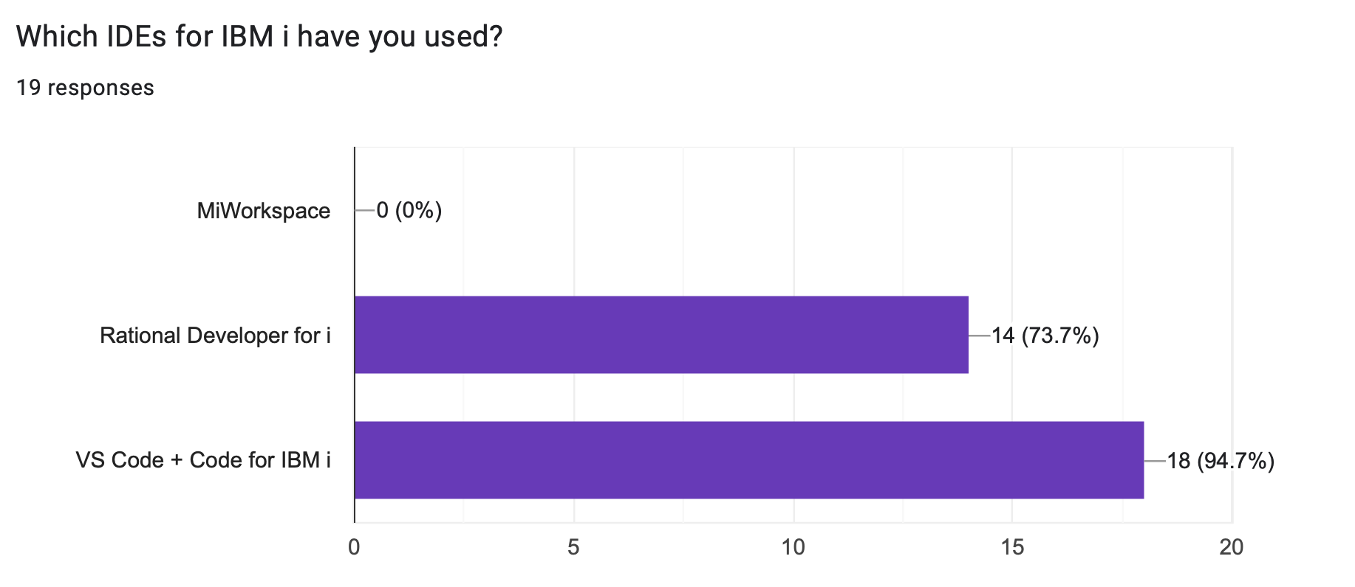
We did a survey…

Slide 9



Do not edit How to change the design
Have you done unit testing with IBM i before?
The Slido app must be installed on every computer you’re presenting from

Slide 10
Do not edit How to change the design
What framework did you use for IBM i testing?
The Slido app must be installed on every computer you’re presenting from

Slide 11
Do not edit How to change the design
Have you used CODECOV on IBM i?
The Slido app must be installed on every computer you’re presenting from

Slide 12
Basics of RPGUnit

Slide 13
Naming requirements
A test case …
is an exported procedure
starts with the name test
test_getEmployeeDetail
test_getDeptDetail
testIsPalindrome
testFactorial
A test suite …
has no naming requirements
but the extension requires that …
local files are suffixed with .test.rpgle, .test.sqlrpgle, .test.cblle, or .test.sqlcblle
and recommends that …
source members are prefixed or suffixed with T, _T, T_, etc.
Code Coverage

Slide 14
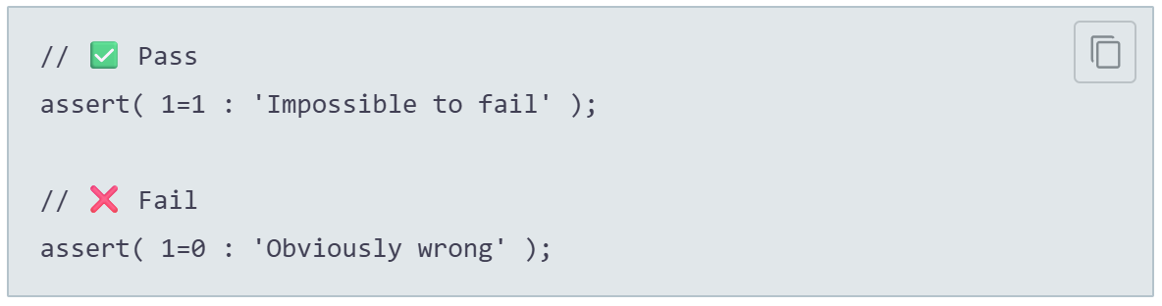
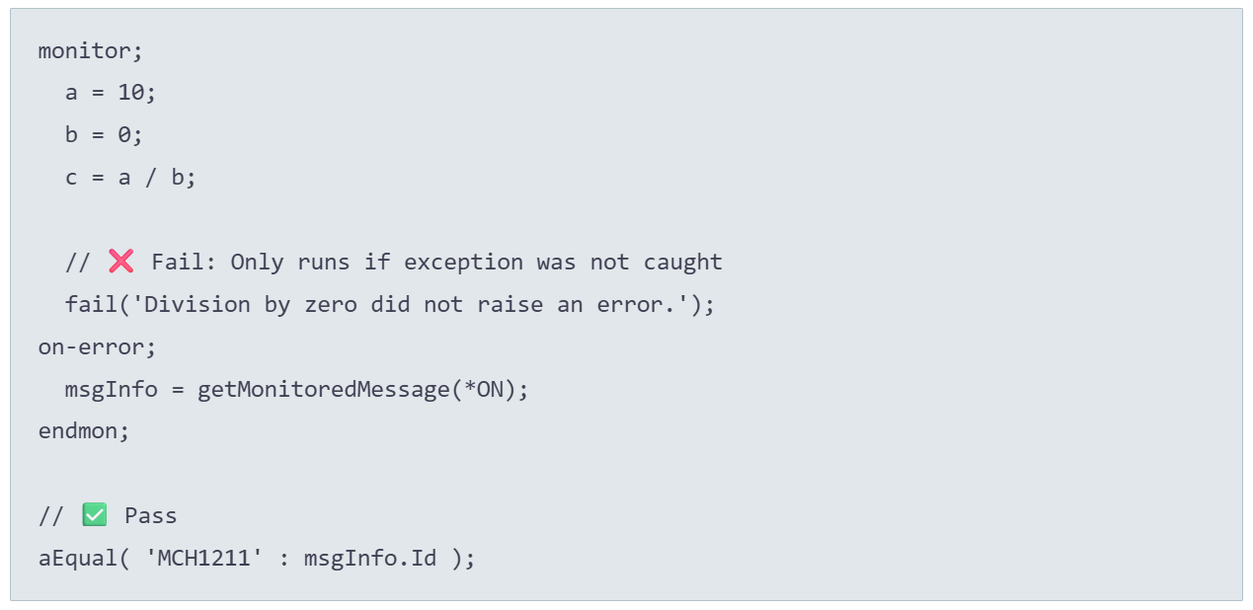
Assertions & utilities
💡Add the copybook: /include qinclude,TESTCASE
Example Assertions:
Example Utilities:
Code Coverage

Slide 15
Set up and tear down
RUCALLTST
💡Add the copybook: /include qinclude,TESTCASE
Unit Test Suite
setUpSuite()
setup()
For Each Test Case
testWhatever()
teardown()
Code Coverage
tearDownSuite()
End

Slide 16
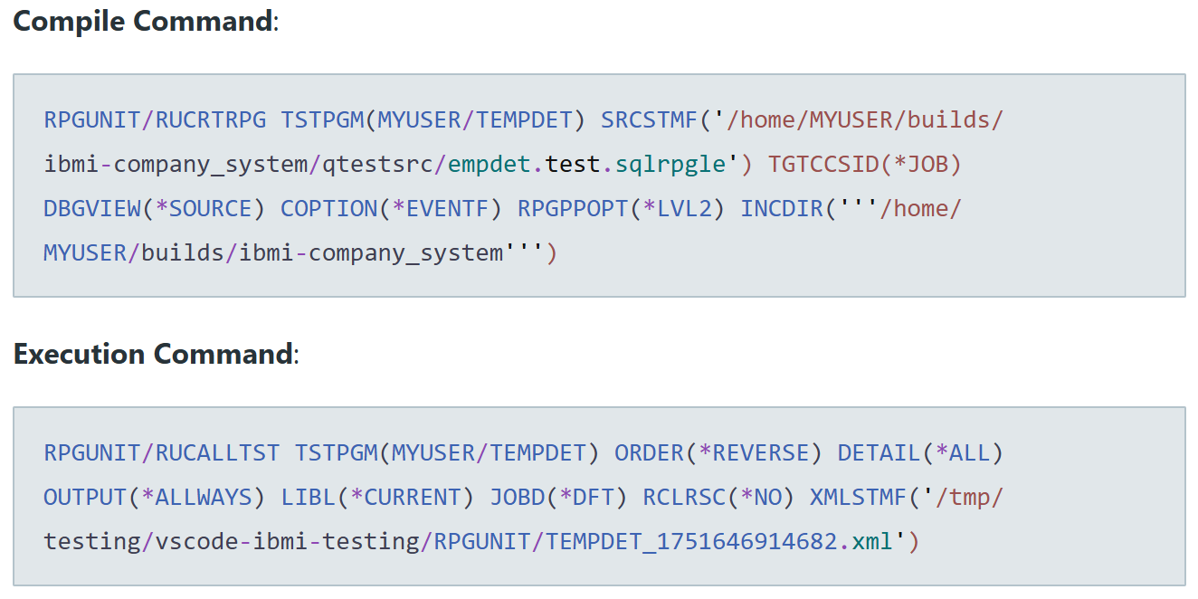
Compile and execution commands
Code Coverage

Slide 17
IBM i Testing Extension Demo

Slide 18
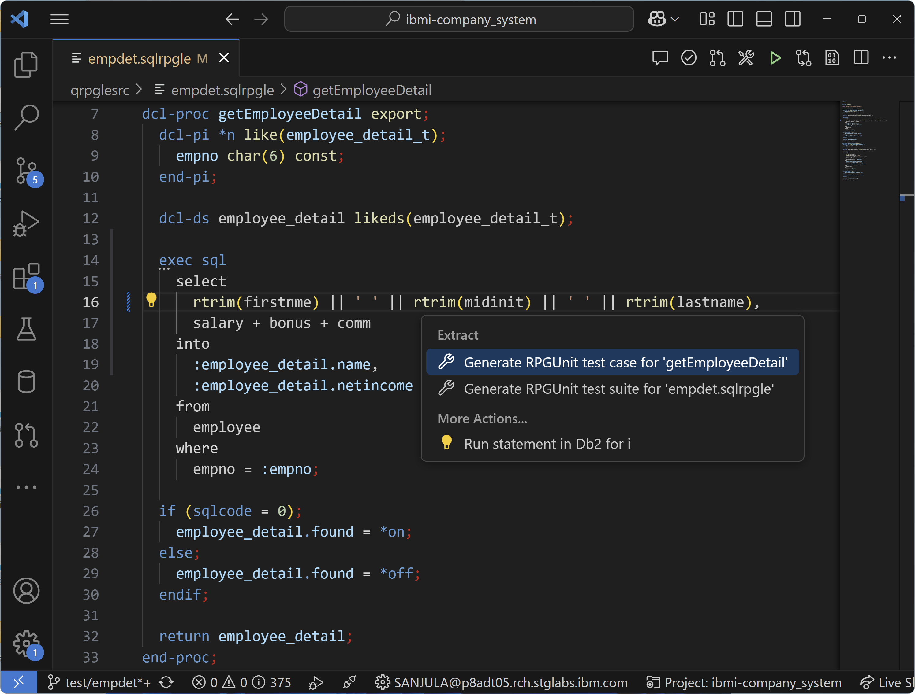
Generating test stubs

Slide 19
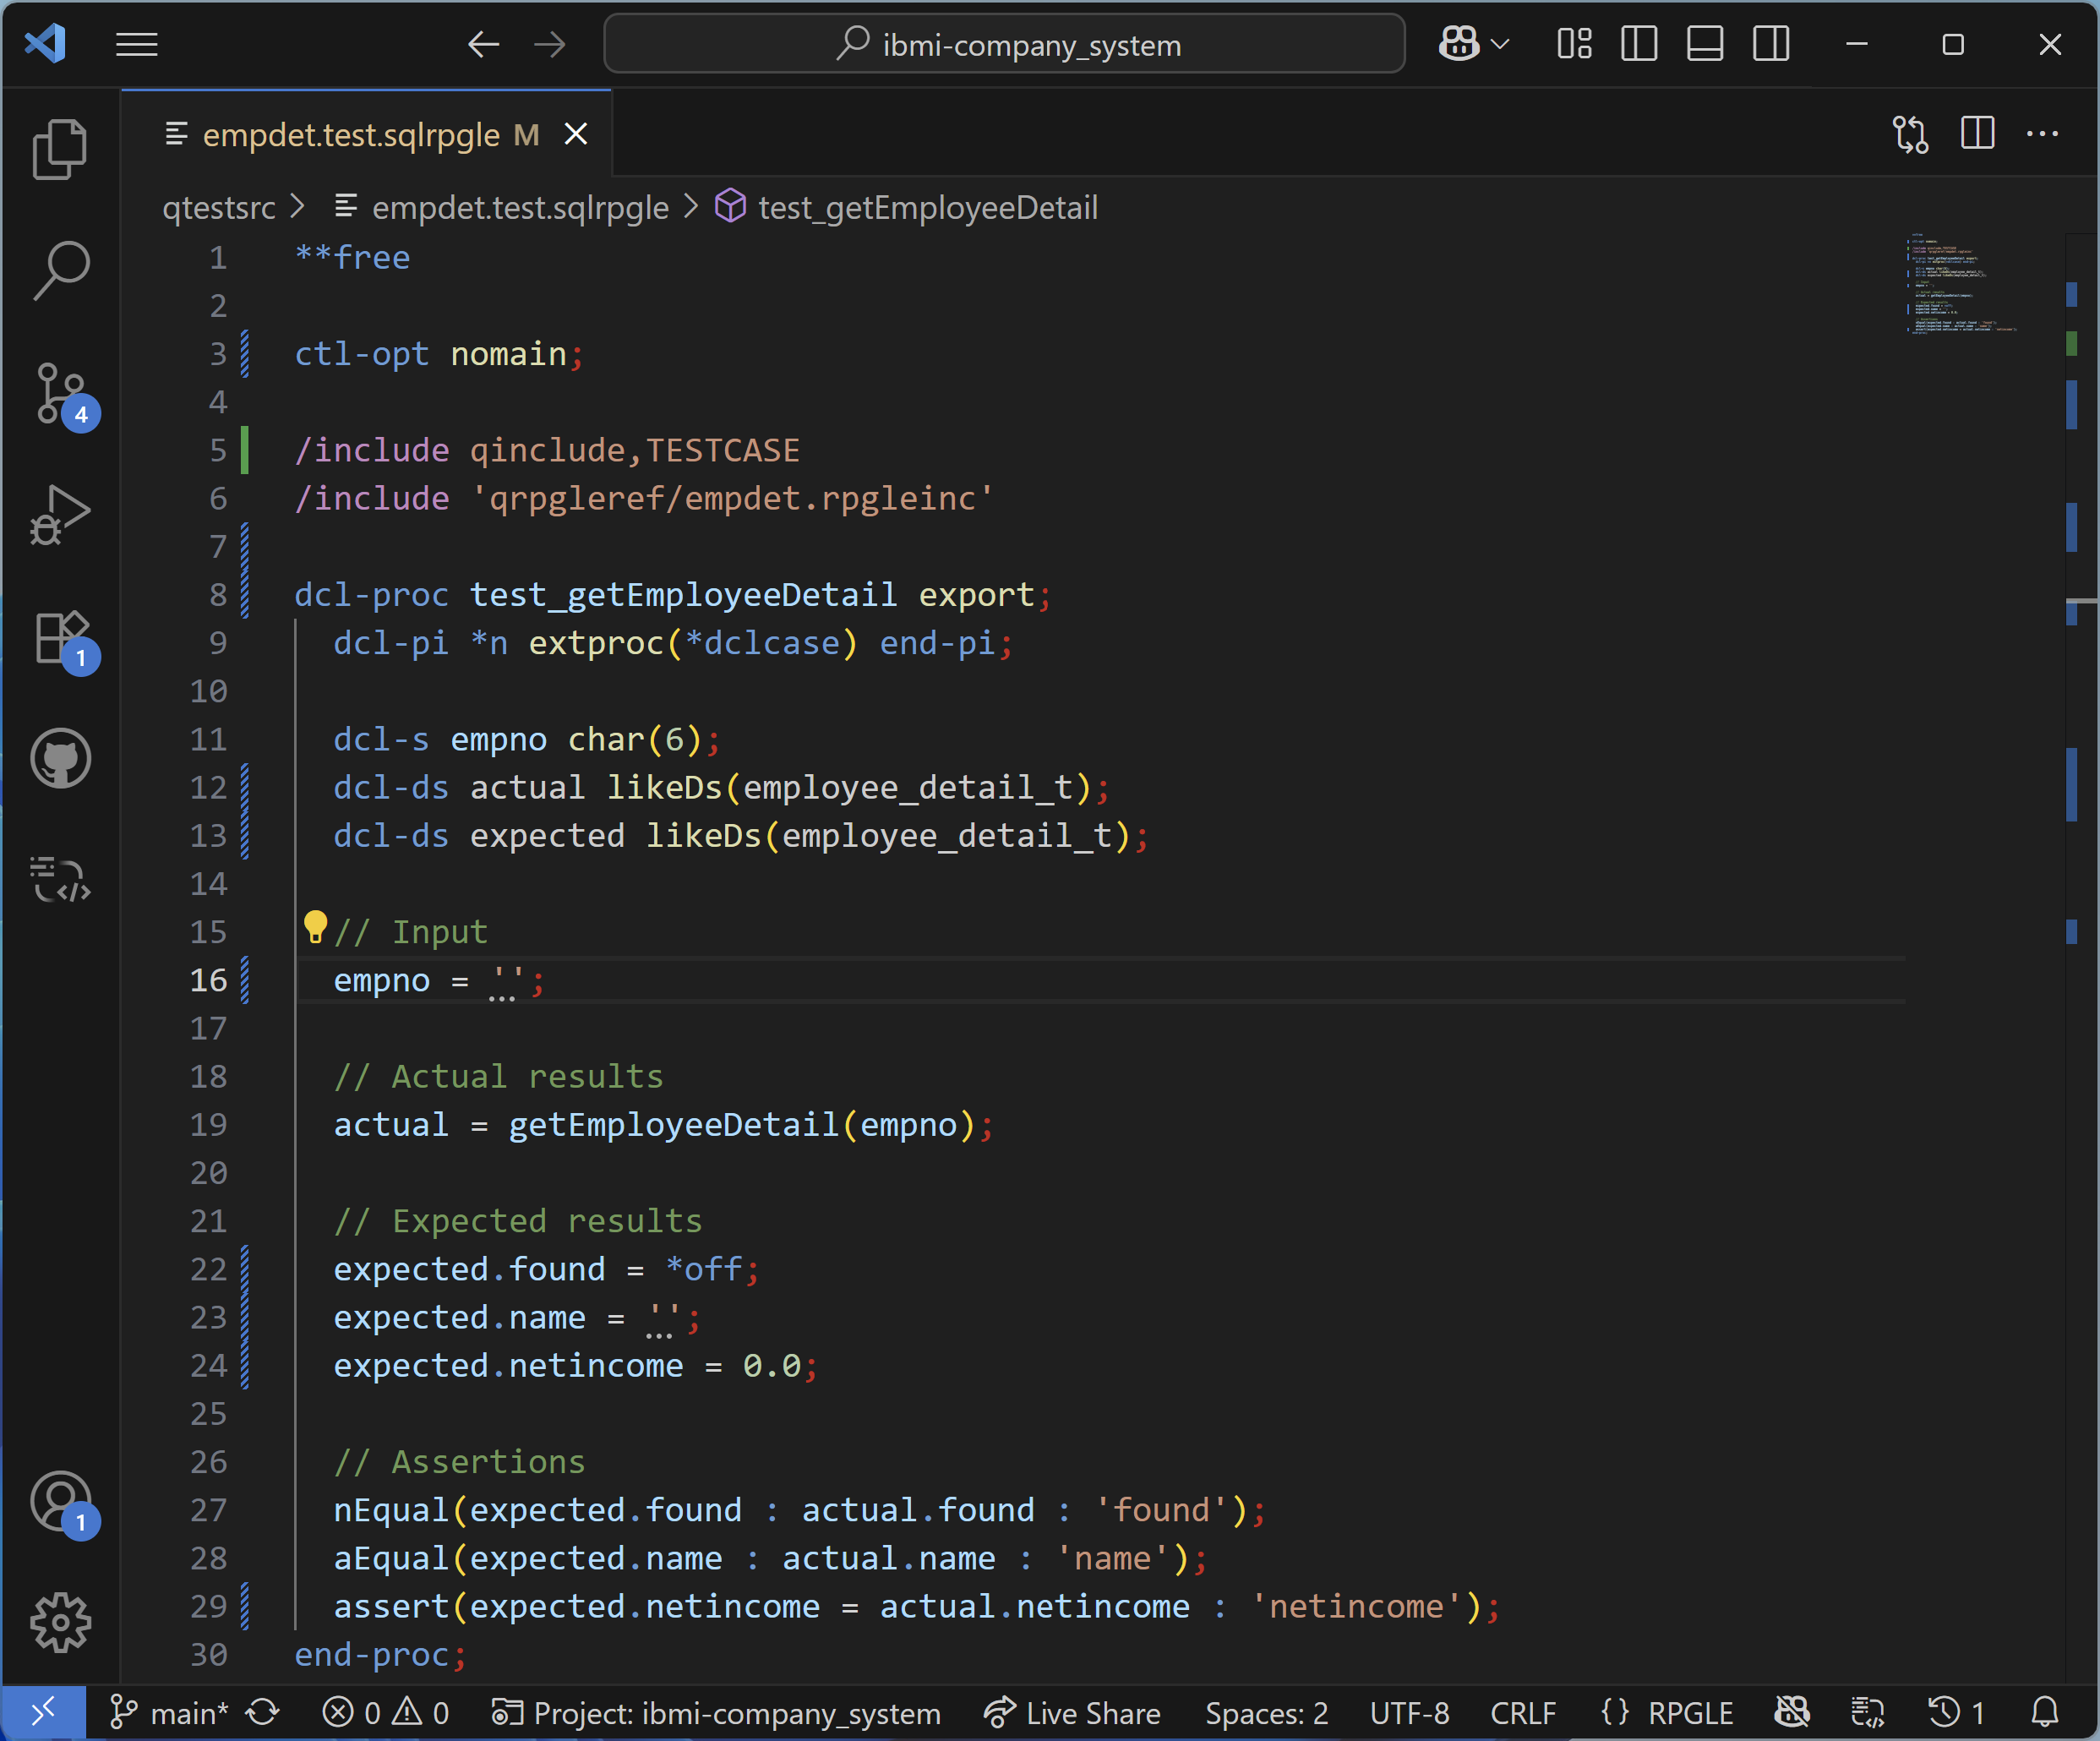
Generating test stubs

Slide 20
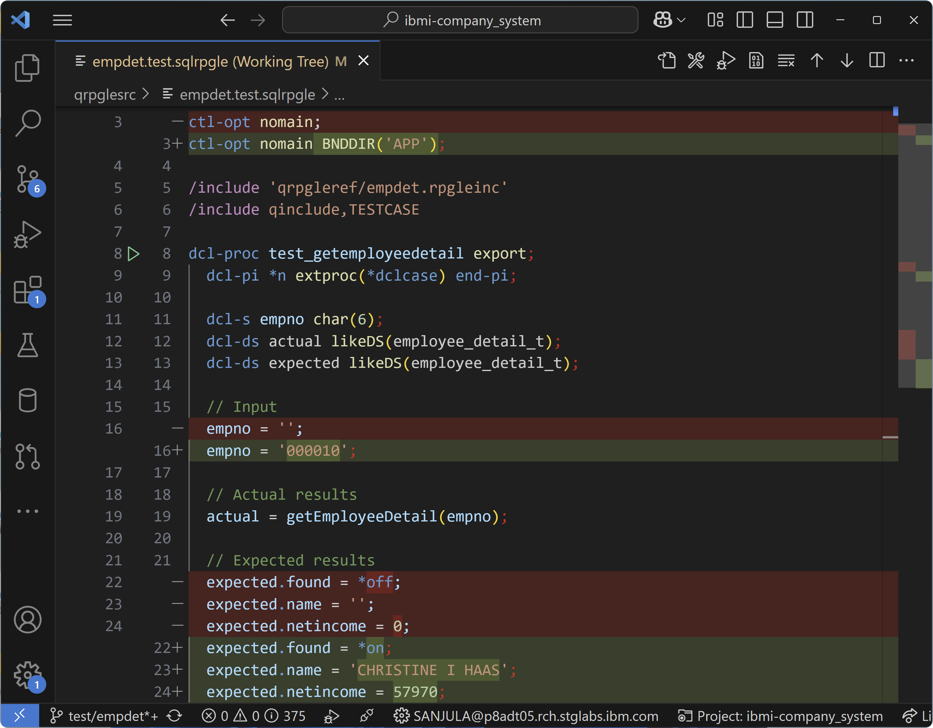
Writing tests

Slide 21
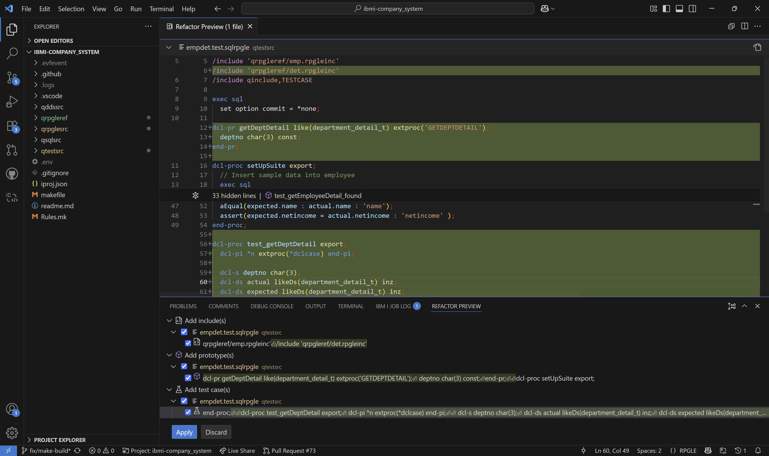
Generating more test stubs (preview mode)

Slide 22
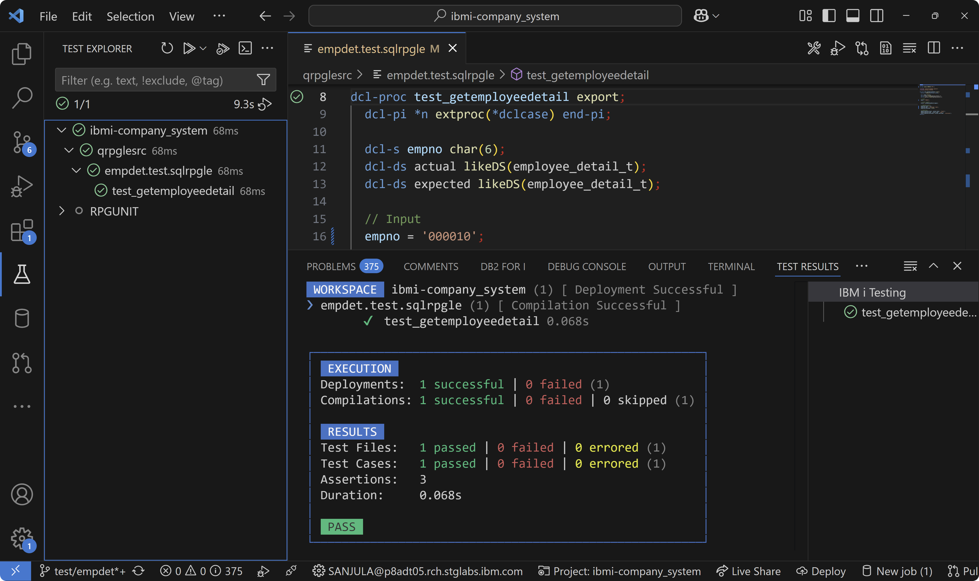
Running unit tests

Slide 23
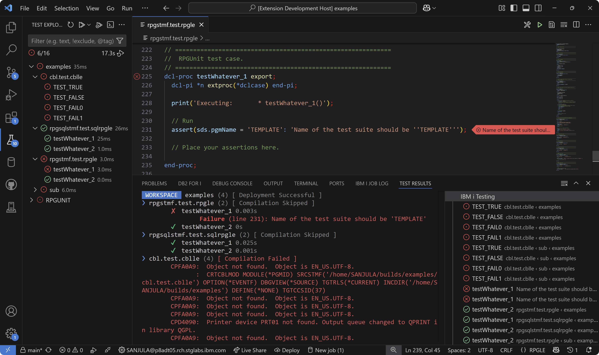
Viewing failures and errors

Slide 24
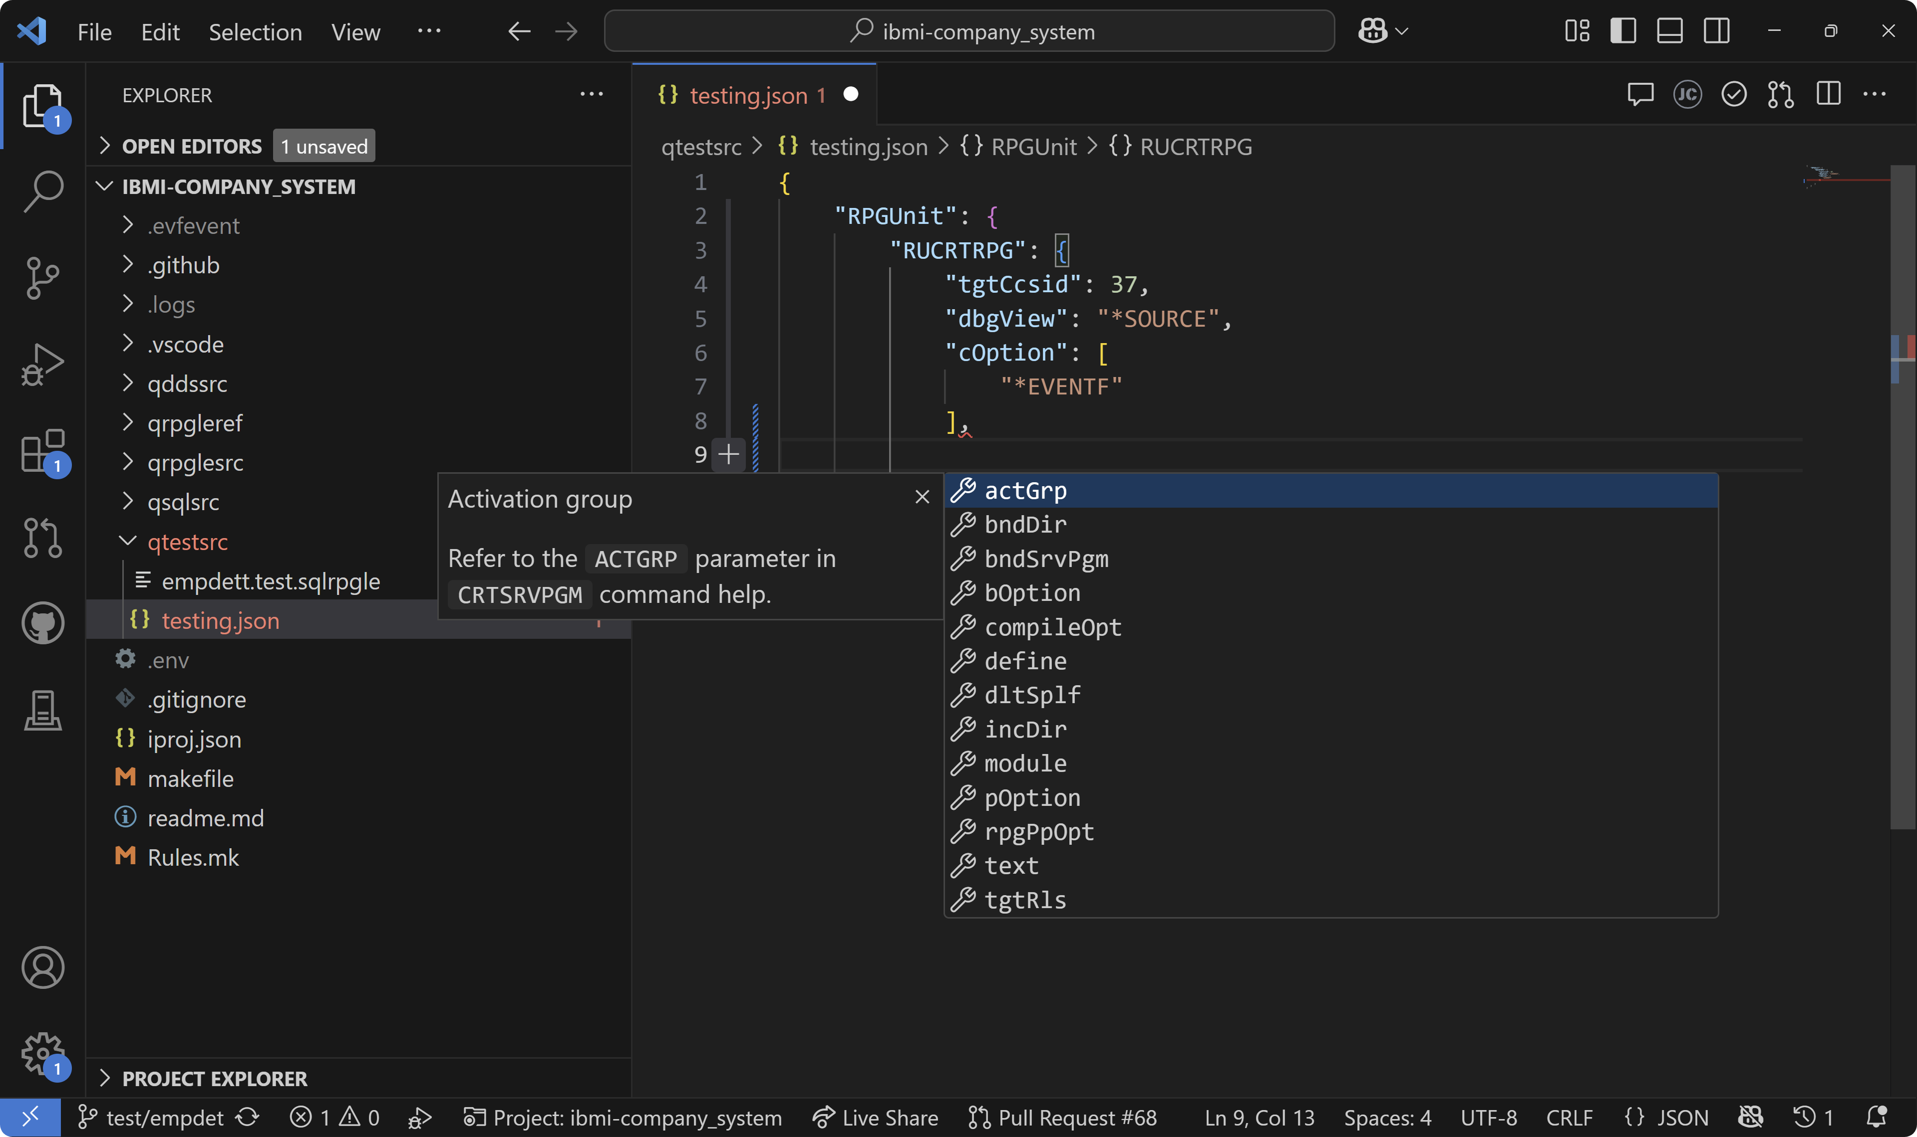
Configuring tests

Slide 25
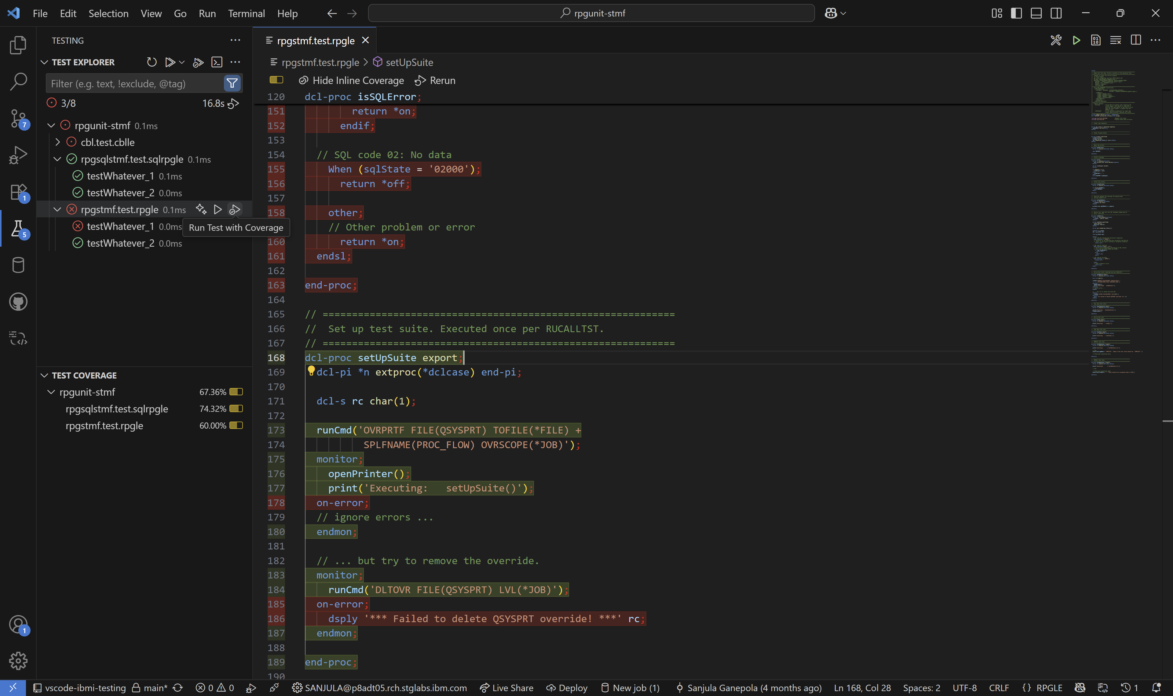
Generating code coverage

Slide 26
IBM i Testing CLI Demo (Soon To Be Released)

Slide 27
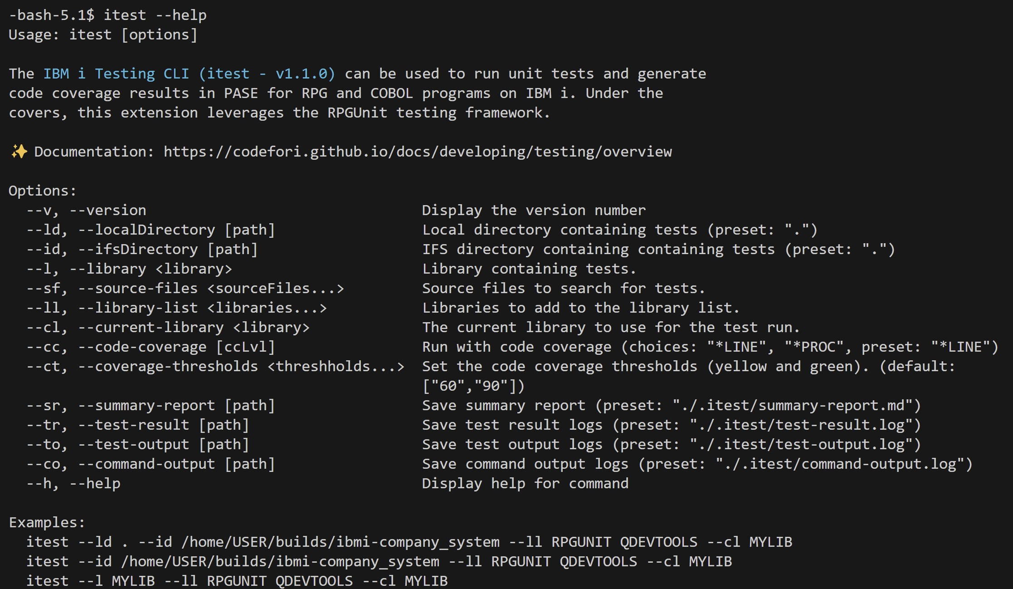
Running tests from a local terminal or in PASE on IBM i

Slide 28
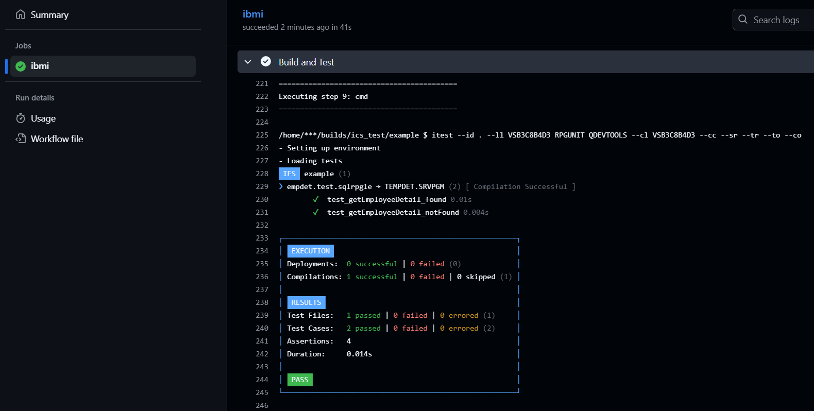
Running tests and code coverage in a pipeline

Slide 29
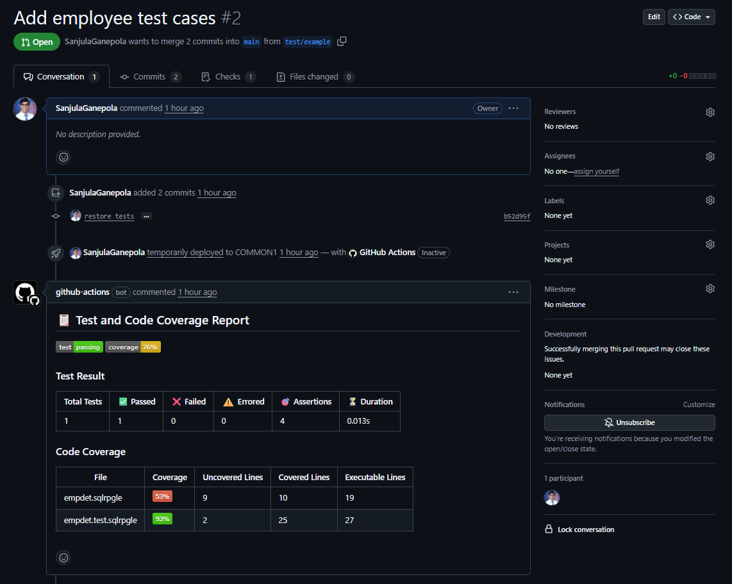
Viewing test and code coverage results

Slide 30
Important Links
IBM i Testing
VS Code Marketplace https://marketplace.visualstudio.com/items?itemName=IBM.vscode-ibmi-testing
Documentation https://codefori.github.io/docs/developing/testing/overview/
GitHub Repository https://github.com/IBM/vscode-ibmi-testing
RPGUNIT
Documentation https://irpgunit.sourceforge.io/help/
GitHub Repository https://github.com/tools-400/irpgunit
Sample Projects
Company System Demo https://github.com/IBM/ibmi-company_system
RPGUTILS https://github.com/IBM/vscode-ibmi-testing/tree/main/examples/rpg-utils
VS Code
Documentation https://code.visualstudio.com/docs/editor/testing

